Slide 1
ECE Class kit Vending machine Team 5
Dillon Williams
Ryan Reed
Austin Sigg
Nidhay Patel
Michel Turpeau

Slide 2
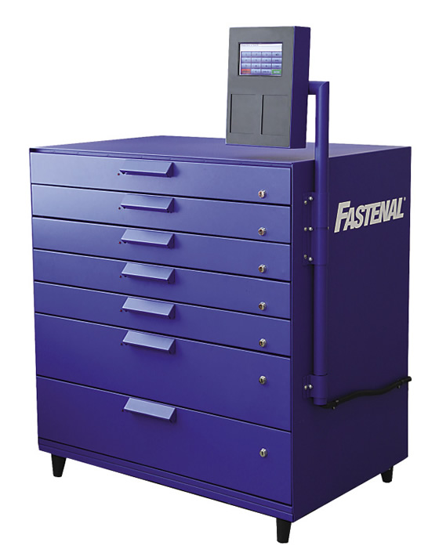
Project Overview
A Vending Machine
Vends boards & stores student data
Why?
Reduce Work of ECE office Associates
Efficient Process
Saves time

Slide 3
Specifications
Trays shall be 10in wide and 10in long
Communication shall be by ethernet
Shall have a database to hold information
Shall have nonvolatile memory To account for power loss
The machine shall direct the student to the board using LEDs
Shall have locks that are not easily broken
Constraints:
Boxes shall have the barcode scanned before dispensing
Shall have an eagle card reader to identify students
Must be window height to be easily portable

Slide 4
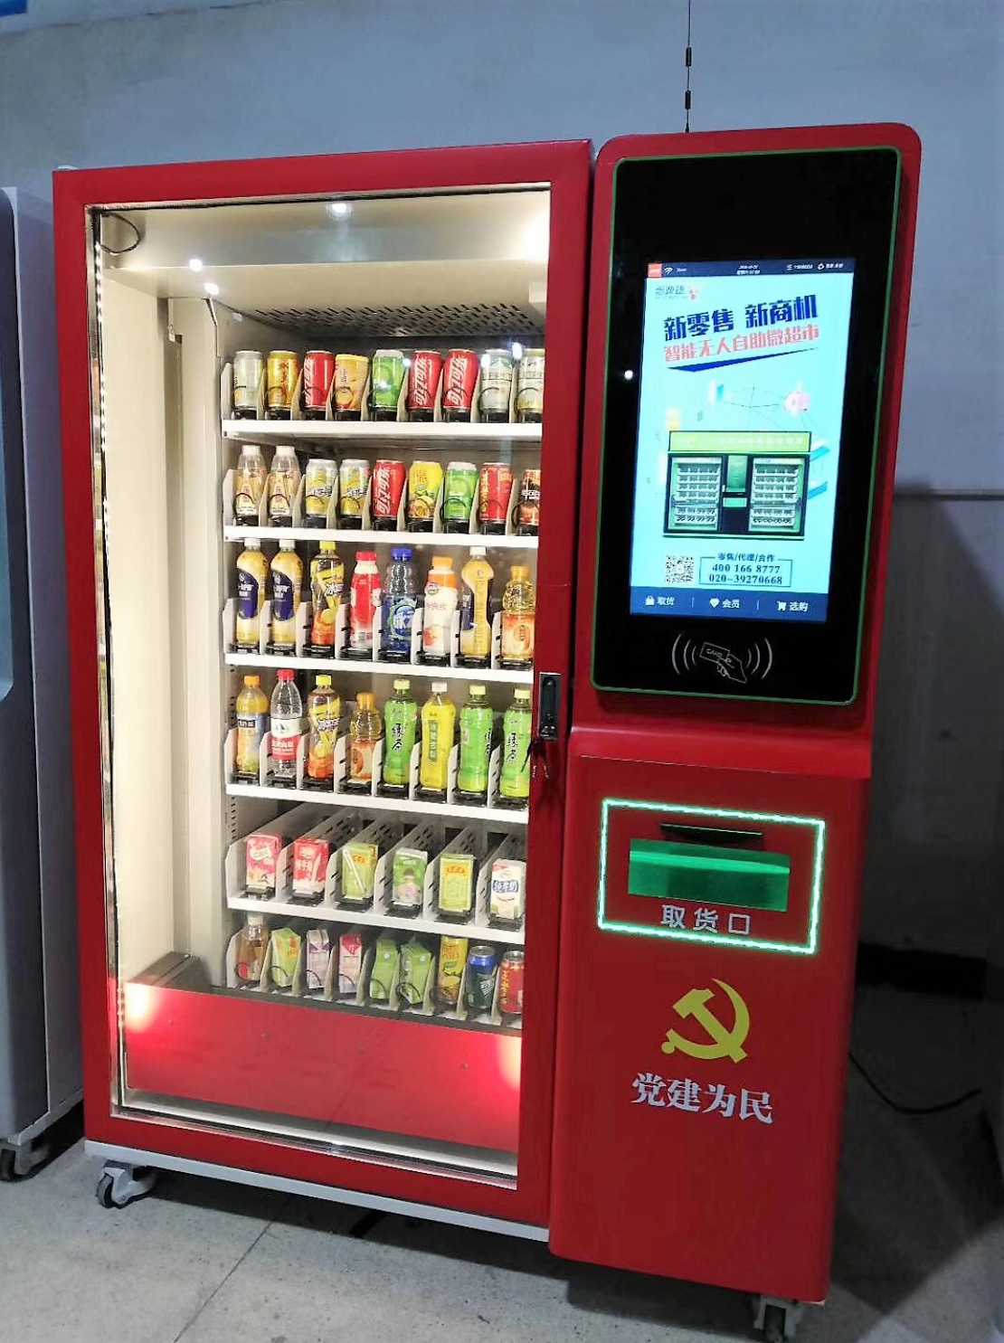
Existing Solutions
Elevator Vending Machine
PROS:
Safety of Devices
Decent Inventory
CONS:
Shelf Customization Decreases Inventory
Machine Size (6’4”H x 4’7”L x 3’3”W)
PRICE:
Unknown, but generally > $2500 (Lift itself > $1000)

Slide 5
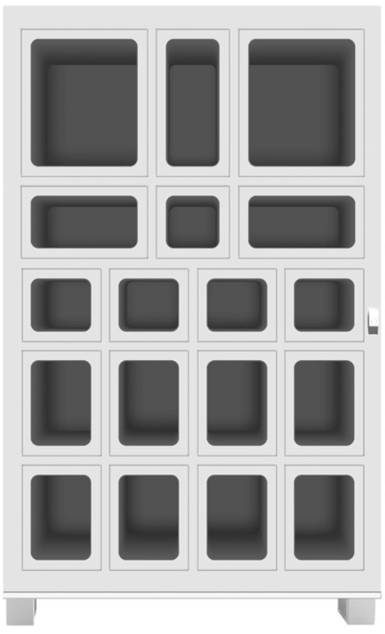
Existing Solutions
Lockerbox Array
PROS:
Various Sized Boxes
Locks for each device
CONS:
Storage / Refilling
Locks must have Strong Resistance
Price:
Generally $700 - $2000+

Slide 6
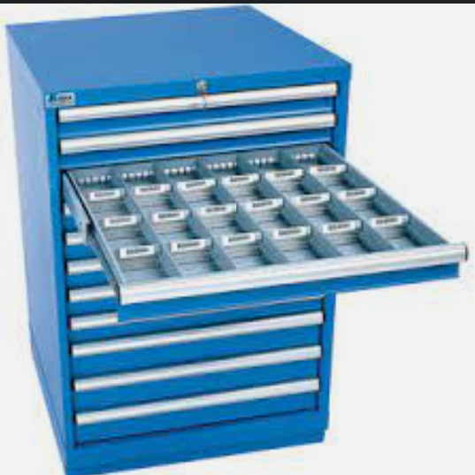
Proposed Solution
“Fastenal Drawer Cabinet” style from Mechanical Team
Solenoid Coil Locks on Drawers
Each Drawer will contain ~4 - 6 devices
LEDs will indicate which drawer & device is selected
Interface will be on the top
Software & Hardware will be in back

Slide 7
Proposed Solution
Systems:
PLC/Microcontroller
Database
Electronics Control
LED Indication
Power (120 Watt)
Motors
Locks
Ethernet
Communication
Microcomputer
Interface
Critical Unknowns:
Card Reader
What’s on the card?
Can we access it?
Will the Eagle Card Office greenlight the card reader?

Slide 8
Measures of Success
The System must dispense the requested item with sufficient speed
The System must be intuitive for students
The System must correctly scan and store the device bar codes and student information.

Slide 9
Broader Impacts
The Vending Machine will influence the jobs of those who work in the ECE department
There is Risk of asset loss
Possible Safety breach of Tennessee Tech Data

Slide 10
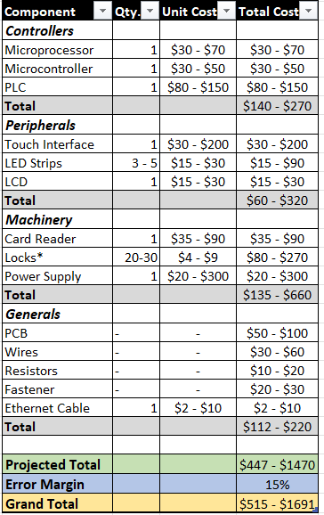
Resources
A list of components possibly needed for current concept.
Does not include the main chassis or other components from the mechanical side.
Final Design will have a condensed range of cost.

Slide 11
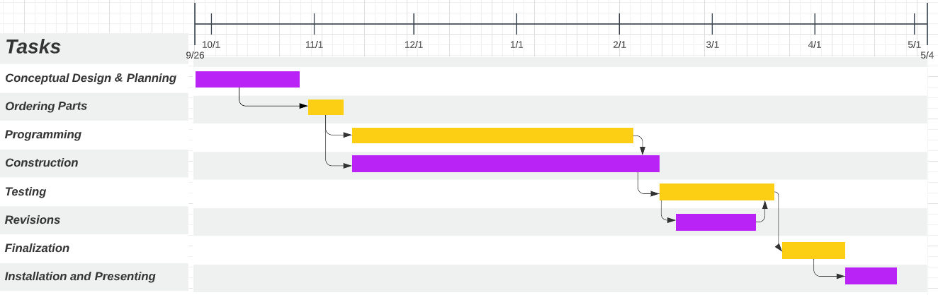
Tentative Timeline

Slide 12

Wrap It Up
This device will be a convenient and efficient way to distribute products while keeping track of inventory.
Easy system for students to procure their needed class kit boards and devices.
Reduce the strain on the employees in the ECE department.
Student motivation.

Slide 13


